Slide 1
Hospital Management System
React Project

Slide 2
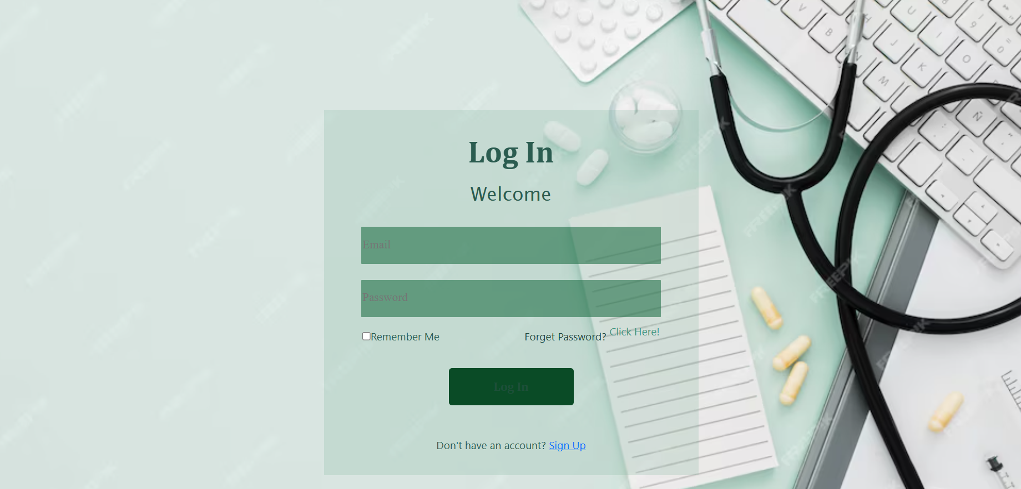

Login & SignUp Page :

Slide 3
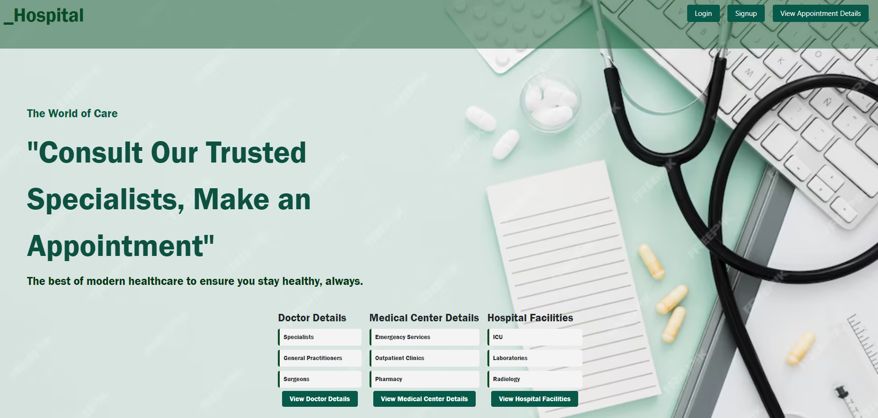
Home Page :-

Slide 4
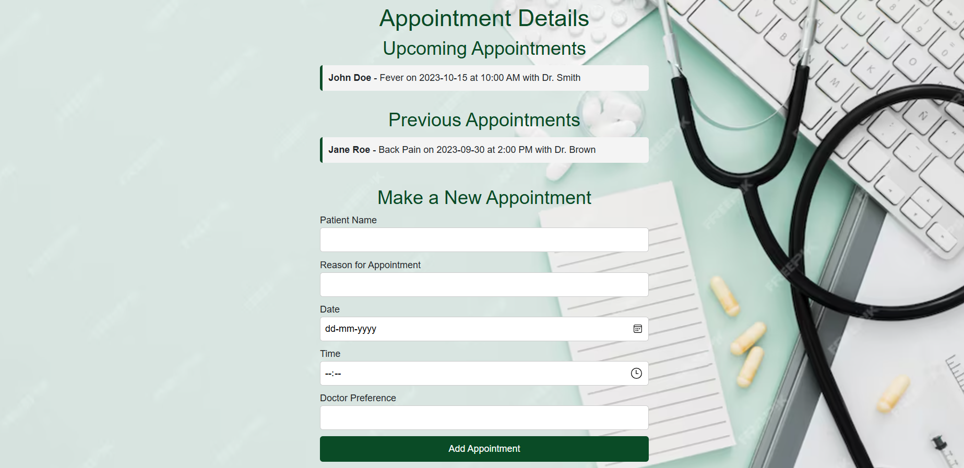
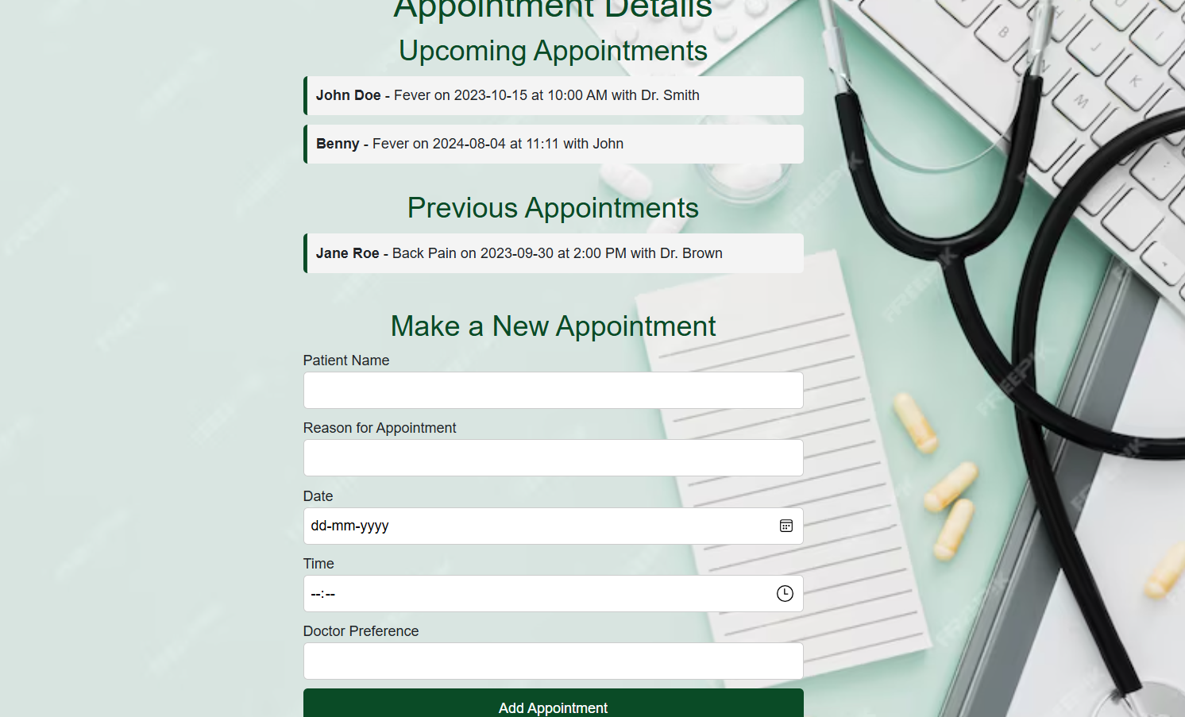
Appointment Form
Before adding Appointment
After adding Appointment

Slide 5
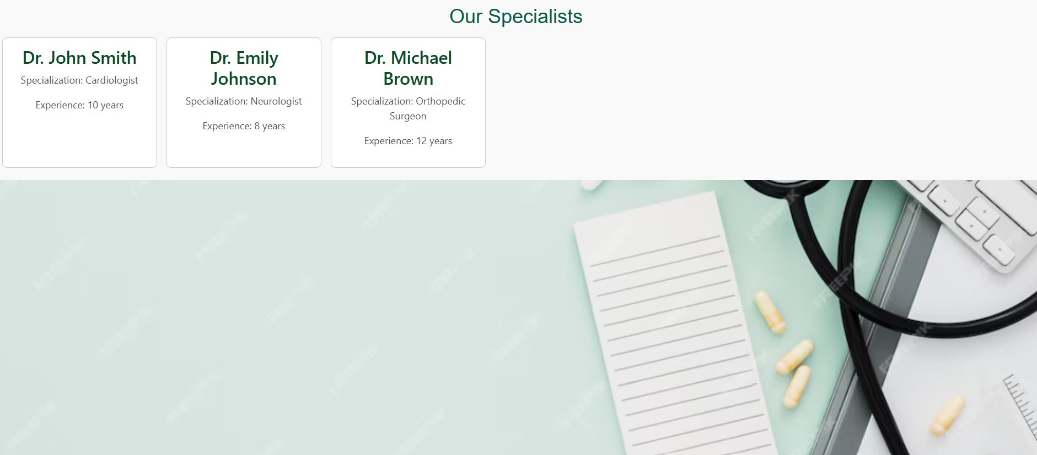
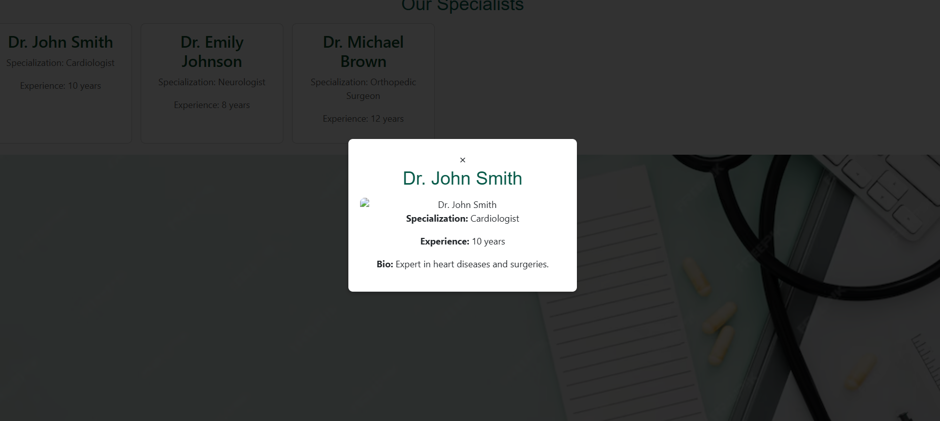
View Doctor Details

Slide 6
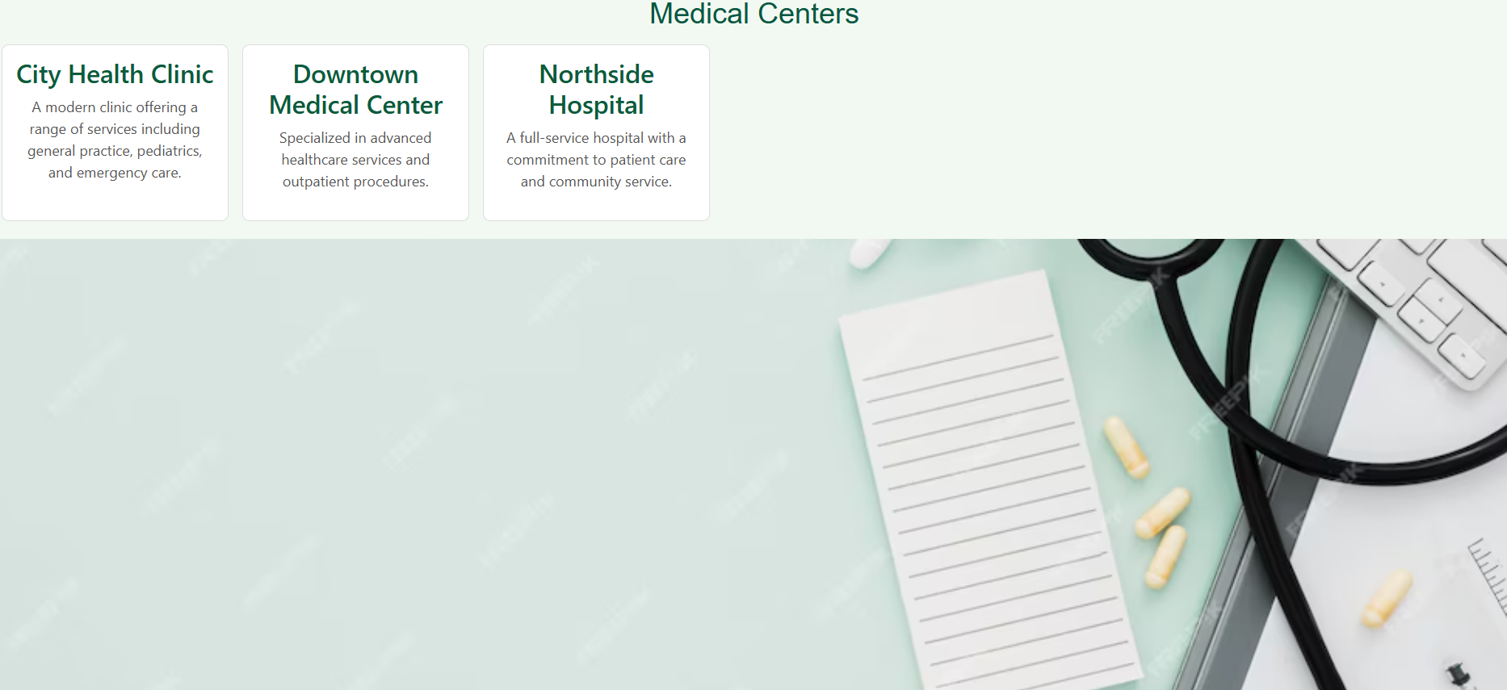
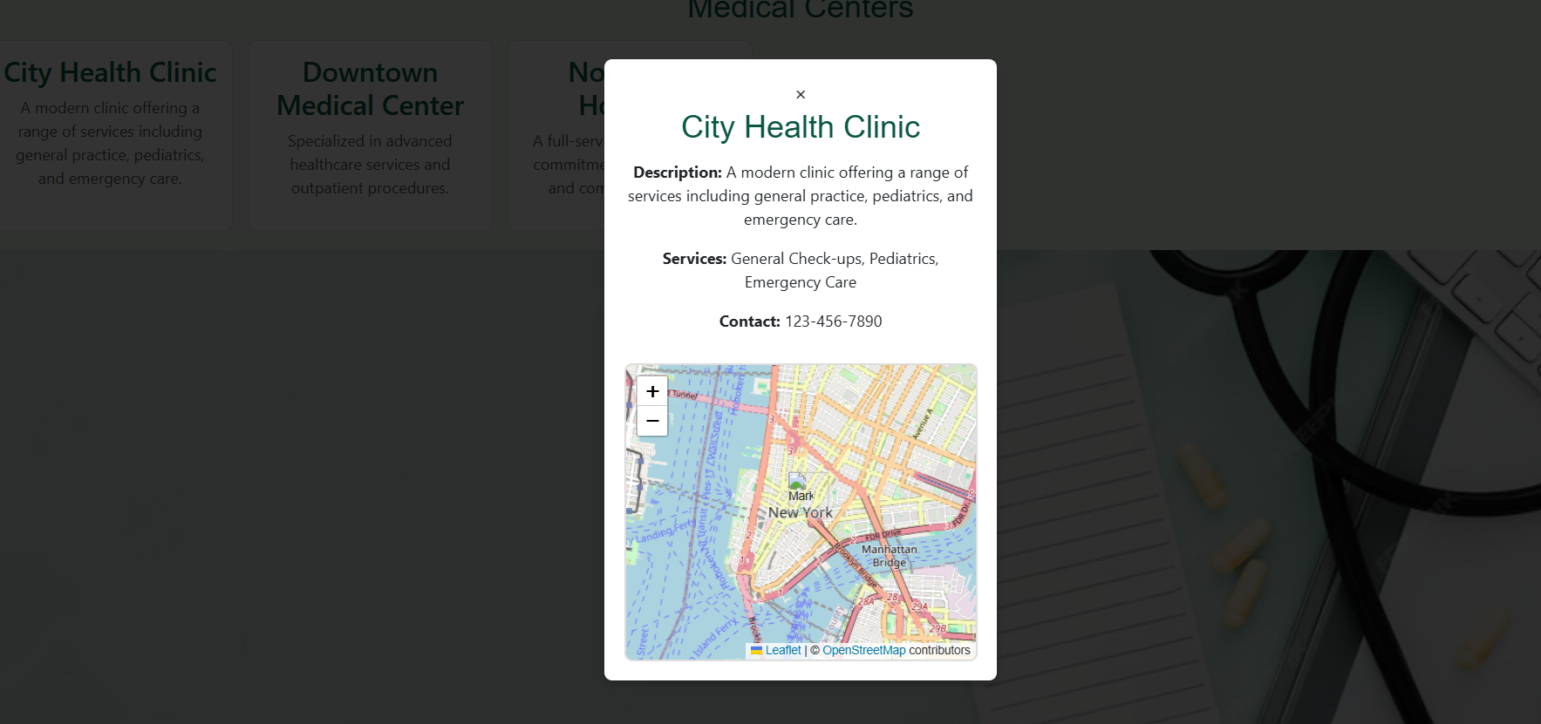
View Medical Center Details

Slide 7
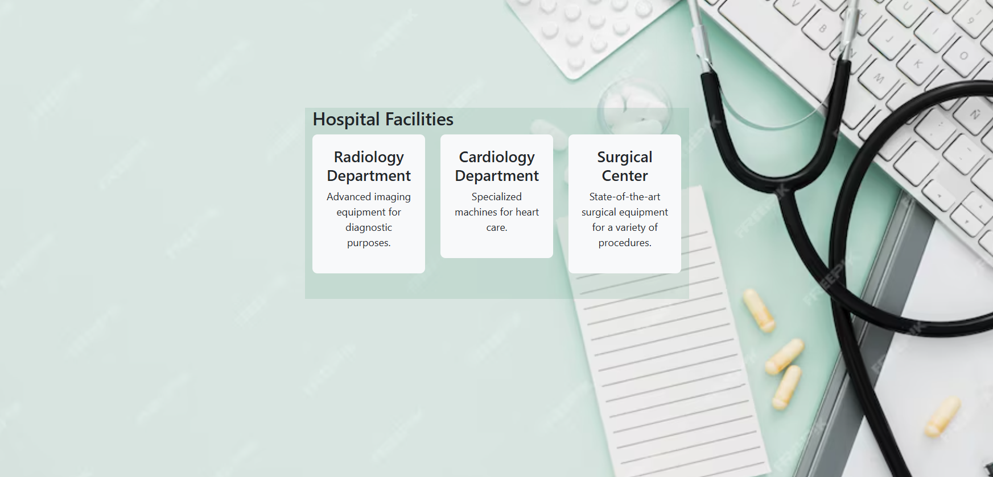
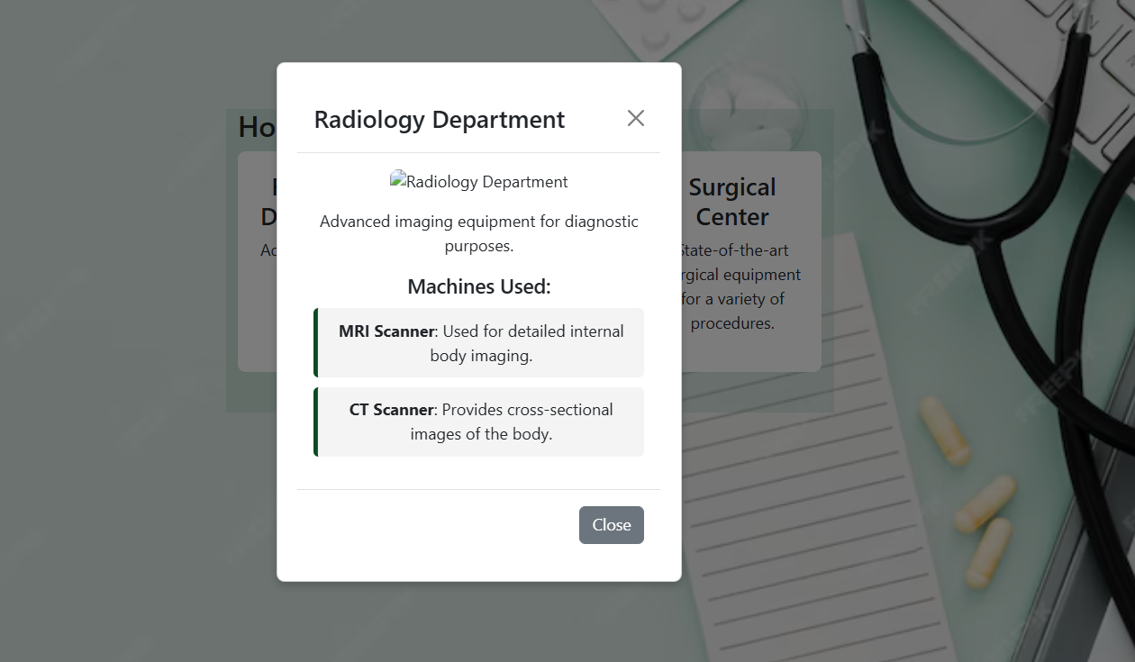
View Hospital Facilities

Slide 8
Advantages of the Website:
User-Friendly Interface:
The website has a clean, intuitive interface that provides easy navigation for users, including patients and doctors.
Comprehensive Patient Information:
Different components (DoctorDetails, PatientDetails, MedicalCenterDetails, etc.) provide users with detailed information about medical services, making the process more efficient.
Login and Signup System:
Secure login and registration systems ensure that user accounts are protected and accessible with proper authentication.
Responsive Design:
The layout is well-structured, which ensures that the website works smoothly across different devices.
Efficient Data Management:
Centralized data (e.g., doctor details, patient information) provides easy access and management, minimizing errors and delays.
Customizable Medical Features:
Modular design allows for flexible changes or updates to the components (DoctorDetails, PatientDetails, MedicalCenterDetails, etc.), making it easy to add more functionalities over time.
Specialized Healthcare Services:
The ability to view and manage information related to doctors, appointments, and medical facilities allows patients to make informed decisions.

Slide 9
Specialty of the Website: 1.Hospital-Specific Focus: 2.Appointment Management: 3.Detailed Medical Information: 4.Responsive and Secure:

Slide 10
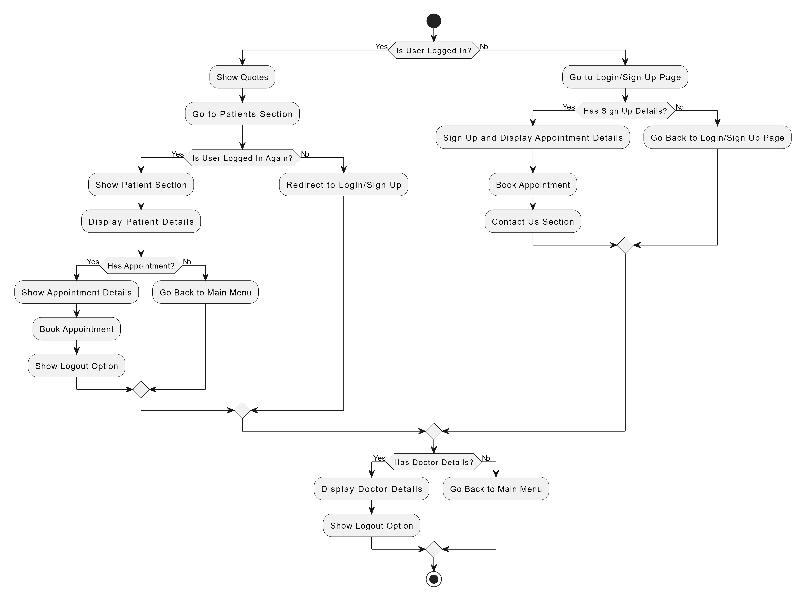
FlowChart

Slide 11
Thank you !!

